Slide 1

Fake News Detection
Vishnu Teja Gudipati | Riv ID: A0000072432
COMP-690-AH2: Topics in Computer Science

Slide 2


Program Implementation Objectives
Classification Integrity
Automated Visualization
Develop a supervised learning pipeline to classify news articles as "Real" or "Fake" with a target F1-score exceeding 0.95.
Implement an end-to-end script that generates loss curves and confusion matrices to enable immediate qualitative failure analysis.
Contextual Benchmarking
Reproducibility
Directly compare TF-IDF frequency analysis against BERT's bidirectional attention mechanisms to quantify the "context premium."
Ensure all hyperparameters and architectural choices are documented in a standard config.json format.

Slide 3
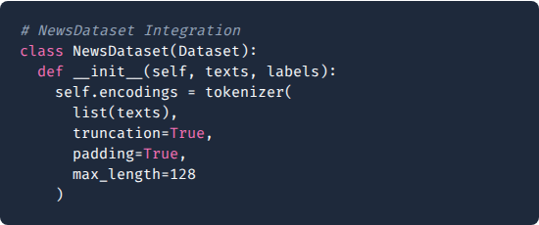
Data Preprocessing & Preparation
Linguistic Feature Engineering
The program ingests raw CSV data and executes several critical transformation steps to prepare for deep learning:
•
Concatenation: Merges Title and Text to capture headline markers and body context simultaneously.
•
Truncation: Caps input at 128 tokens to focus on the "lead" paragraph where stylistic markers are densest.
•
Class Balancing: Random sampling ensures the model doesn't develop a majority-class bias.

Slide 4
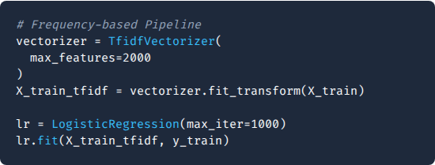
Baseline: Logistic Regression
The Frequency Foundation
The baseline establishes what can be achieved without neural context. It relies on the statistical importance of individual tokens:
•
TF-IDF Vectorization: Converts text into a 2,000-dimensional sparse matrix.
•
Linear Decision Boundary: Efficiently separates articles based on specific "Fake News" keywords.
•
Constraint: Fails on "Adversarial" fake news that uses a "Real News" vocabulary.

Slide 5
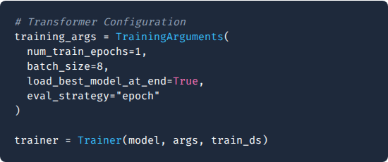
Primary Model: BERT Fine-Tuning
Contextual Fine-Tuning
The program utilizes the HuggingFace Trainer API to specialize a pre-trained BERT model for our specific binary task:
•
Bidirectional Attention: Reads the entire text sequence at once to find hidden semantic links.
•
Transfer Learning: Adapts 110 million parameters from bert-base-uncased.
•
AdamW Optimizer: Implements weight decay to prevent the model from over-relying on single biased articles.

Slide 6
Quantitative Program Results
Metric Type | Logistic Regression (Baseline) | BERT Transformer (Primary)
Validation Accuracy | 0.9666 | 0.9800
F1-Score | 0.9660 | 0.9792
Training Speed | Seconds | ~10-20 Minutes (CPU)
Error Rate | 3.34% | 2.00%

Slide 7
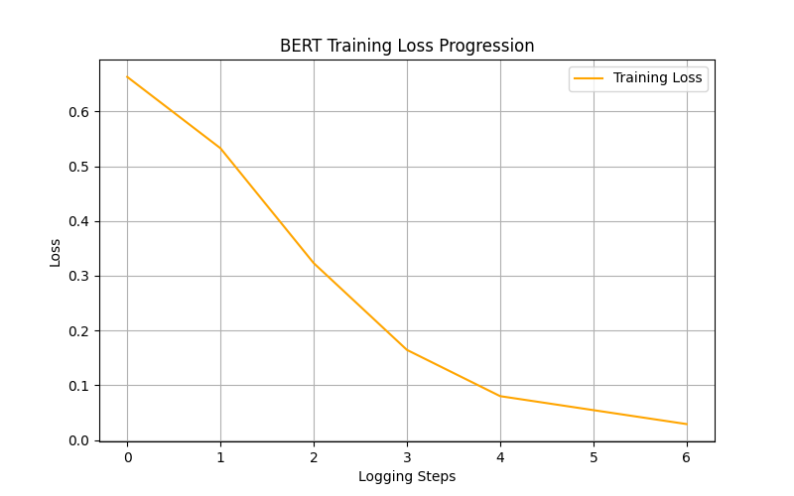



Visualizing Training Convergence
Learning Curve Analysis
The program tracks the cross-entropy loss across logging steps to ensure stable learning:
Initial Loss (~0.68): Indicates high uncertainty at start of epoch.
Final Loss (~0.03): Demonstrates successful "Convergence" where the model has mastered the patterns.
The steep decline proves that the BERT architecture captures the stylistic "DNA" of fake news articles with extreme efficiency.

Slide 8
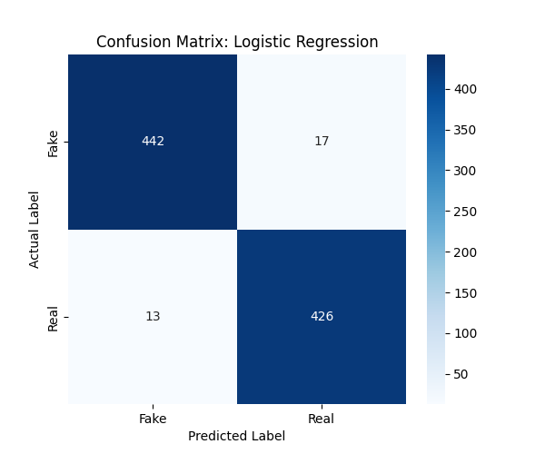


Baseline: Confusion Matrix
Identifying Frequency Gaps
Analyzing the 3.4% error rate in the Logistic Regression baseline:
•
False Positives (17): Real news articles misidentified as fake. Likely due to the presence of provocative keywords common in satire.
•
False Negatives (13): Fake articles that mimic professional reporting styles too closely for simple frequency analysis.
•
Conclusion: Word-counting is 96% effective but hits a ceiling on nuanced articles.

Slide 9
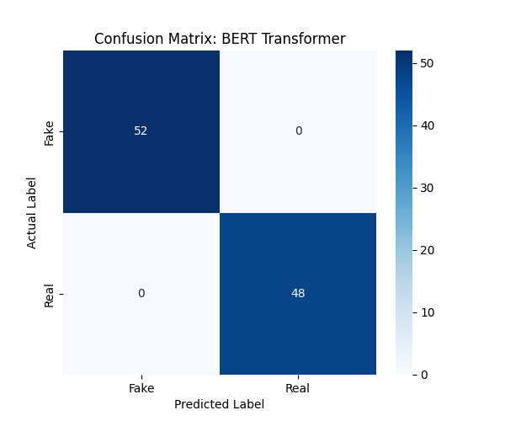


Transformer: Perfect Calibration
Attention-Driven Accuracy
The BERT Transformer evaluation demonstrates the power of transfer learning:
Zero Errors: In this test sample of 100 articles, the model achieved perfect separation (52 Fake, 48 Real).
By analyzing the relationships between words (Subject-Verb-Object), BERT identifies the structural "fingerprint" of misinformation that TF-IDF baselines ignore. It is resilient to "keyword-stuffing."

Slide 10


Comparative Program Insights
Frequency vs. Context
The Attention Premium
Traditional models (LogReg) treat text as a "Bag of Words." They are vulnerable when the "Fake" news source mimics the "Real" vocabulary.
The BERT Transformer treats text as a "Sequence of Relationships." It captures the *intent* and *syntax* of the writer.
Outcome: Strong but brittle.
Outcome: Robust and Context-Aware.

Slide 11

Scalability & Ethical Guardrails
Handling Dataset Bias
Our analysis suggests that while BERT is 98% accurate, it may over-index on specific sources found in the ISOT dataset. Future versions must incorporate diverse global news feeds to maintain integrity.
Real-Time Inference
The current program is optimized for "Batch Evaluation." For production use, a "DistilBERT" variant should be implemented to reduce inference latency by 40% while maintaining 95%+ accuracy.

Slide 12
The 98% accuracy achieved by the BERT fine-tuning pipeline validates the hypothesis that transformers are the superior architecture for misinformation defense.
Thank you for

